Slide 1


Social Buzz Analysis Report

Slide 2


Today's agenda
Project recap
Problem
The Analytics team
Process
Insights
Summary

Slide 3

practice
The task focuses on the following
- An audit of their big data practice
- Recommendations for a successful IPO
- An analysis of their content categories that highlights the top 5 categories with the largest aggregate popularity
Project Recap

Slide 4

Problem
With over 100,000 contents per day and 365,000 contents per year, the organization faces significant data management complexity, necessitating an analysis of the top 5 categories of the content.

Slide 5

The Analytics team
Oluwatosin Adeoye

Slide 6
Data Preprocessing
1
Loading of the dataset
Missing values were treated by removing them and irrelevant columns were removed
2
3
Incorrect data type were changed
The three dataset were merged together to create a unified dataset for analysis
4
5
The date columns were converted to pandas datetime for easy handling of the data

Slide 7
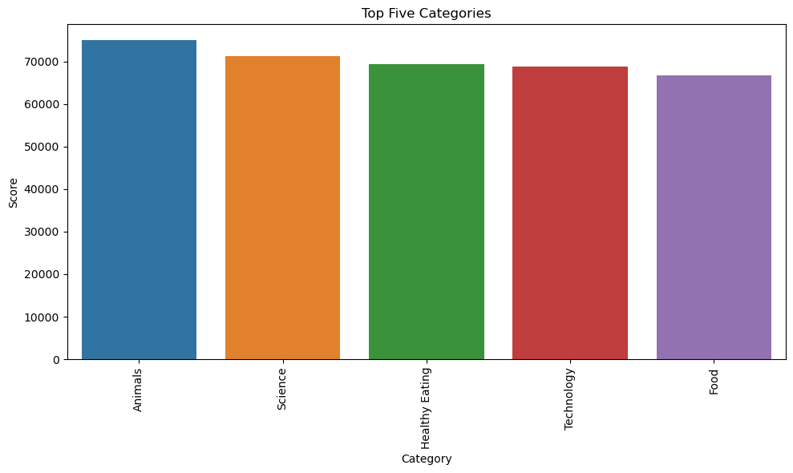

Insights
Top Five Categories
The Top five categories are Animals, Science,
Healthy Eating, Technology and Food

Slide 8
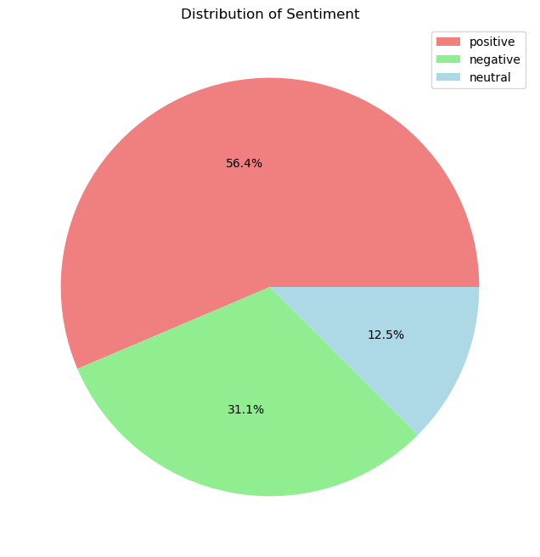
Sentiment Distribution

Slide 9
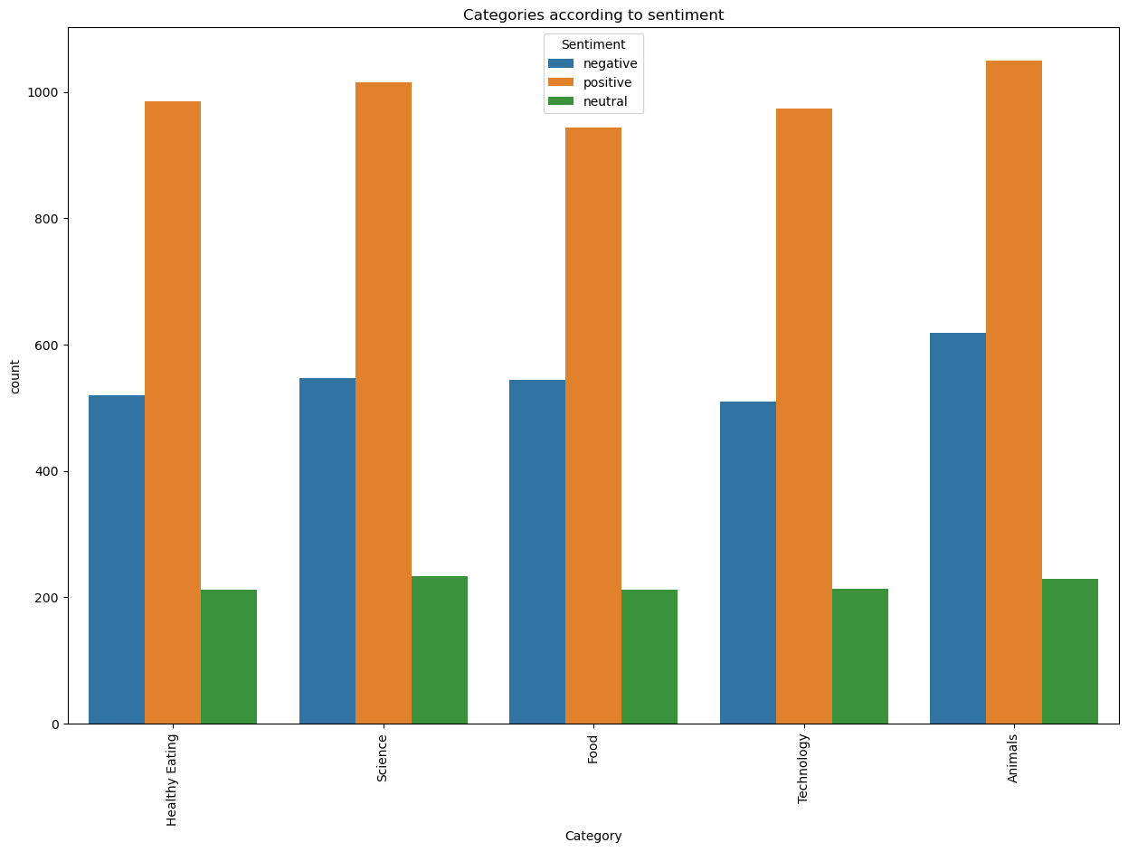
Top Five categories grouped according to sentiments

Slide 10
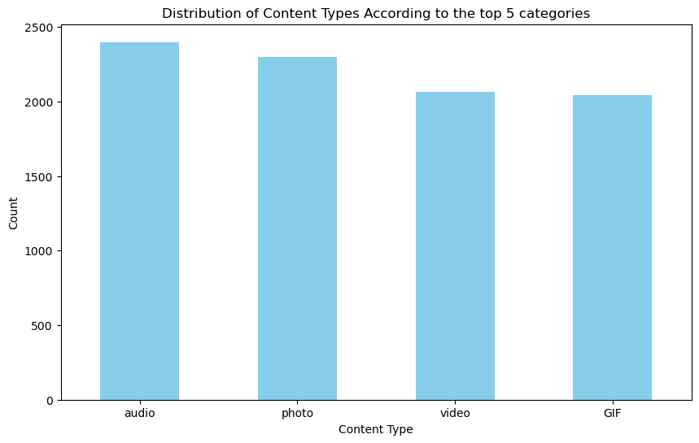
Distribution of content type according to the Top 5 categories

Slide 11
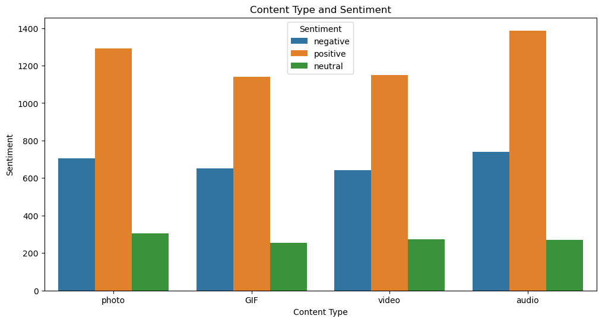
Content Type and Sentiments

Slide 12
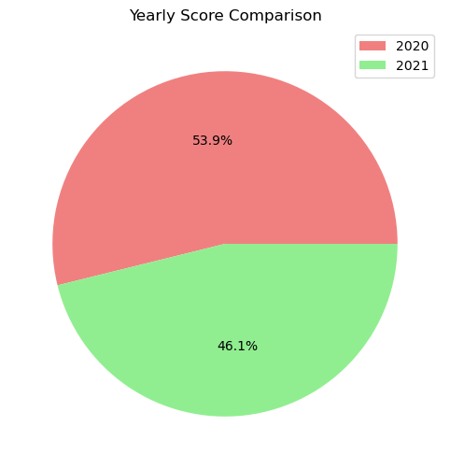
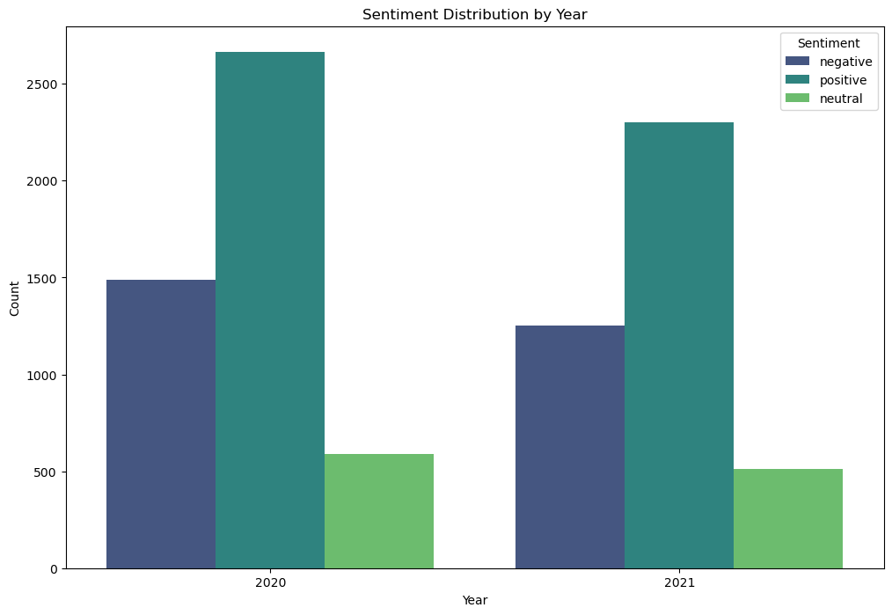
Yearly Score Comparison

Slide 13
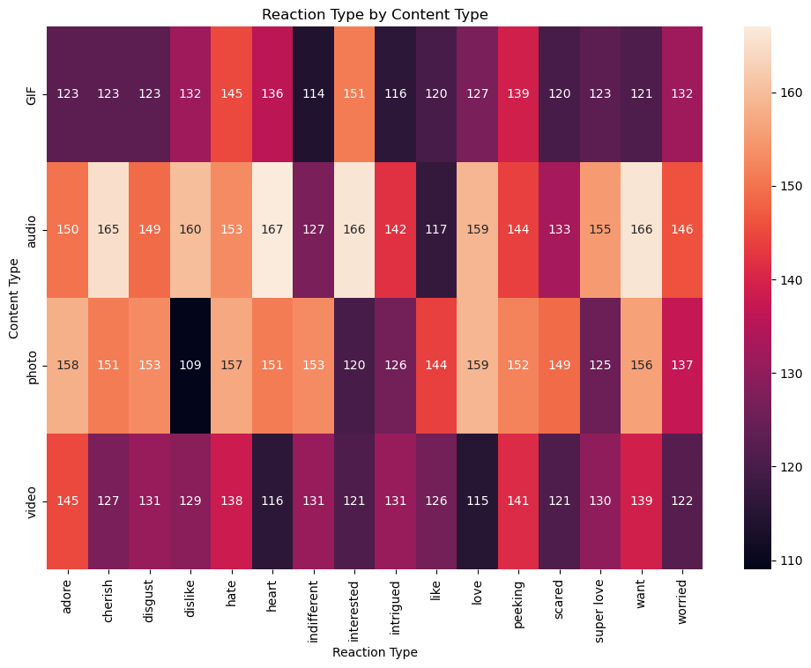
Reaction Type of the Top 5 Categories

Slide 14
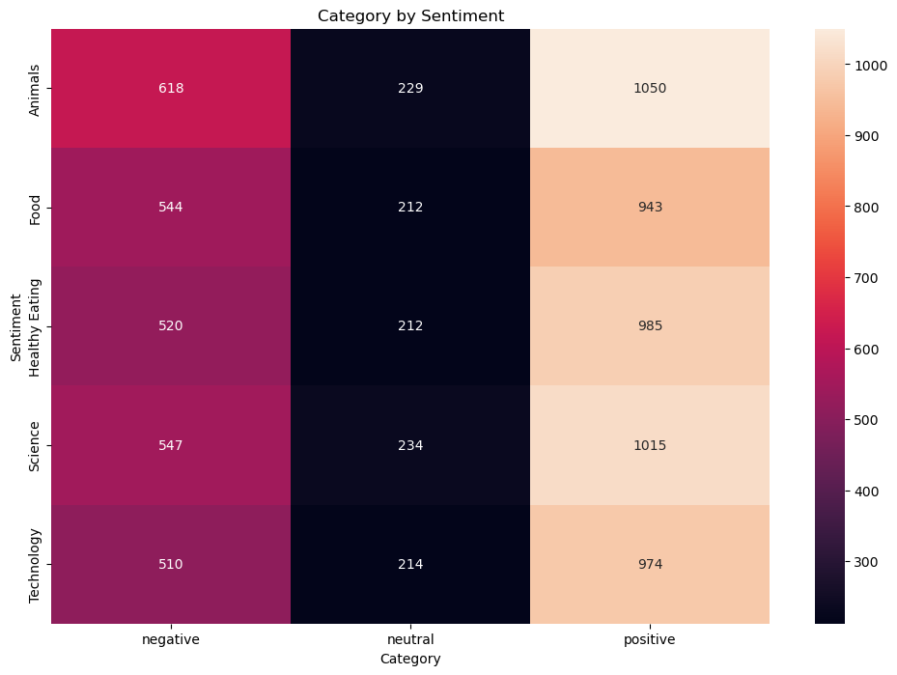
Sentiments of the Top 5 Categories

Slide 15
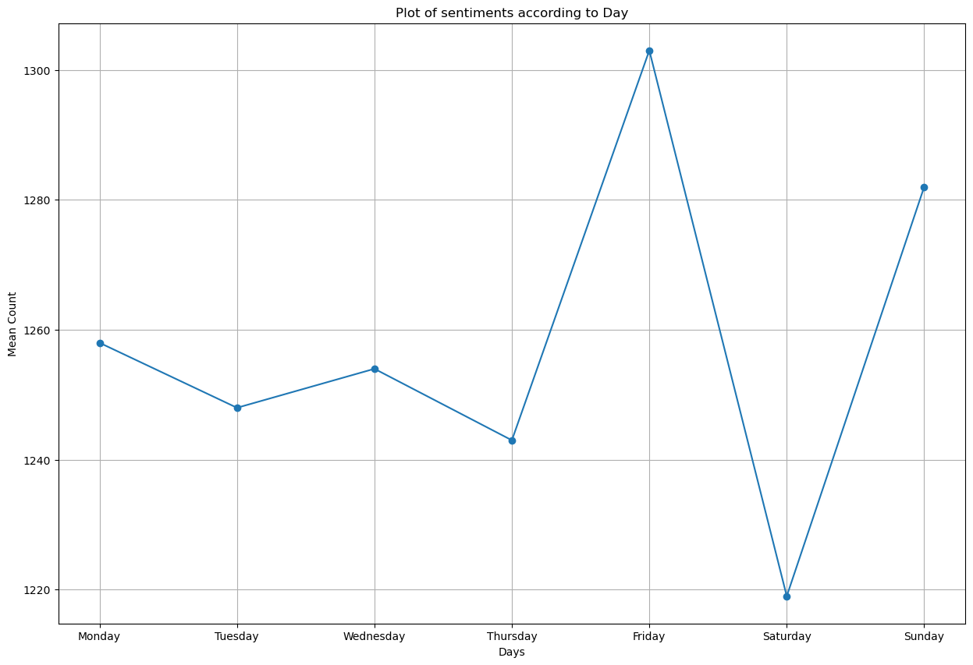
Post according to Days of the week

Slide 16
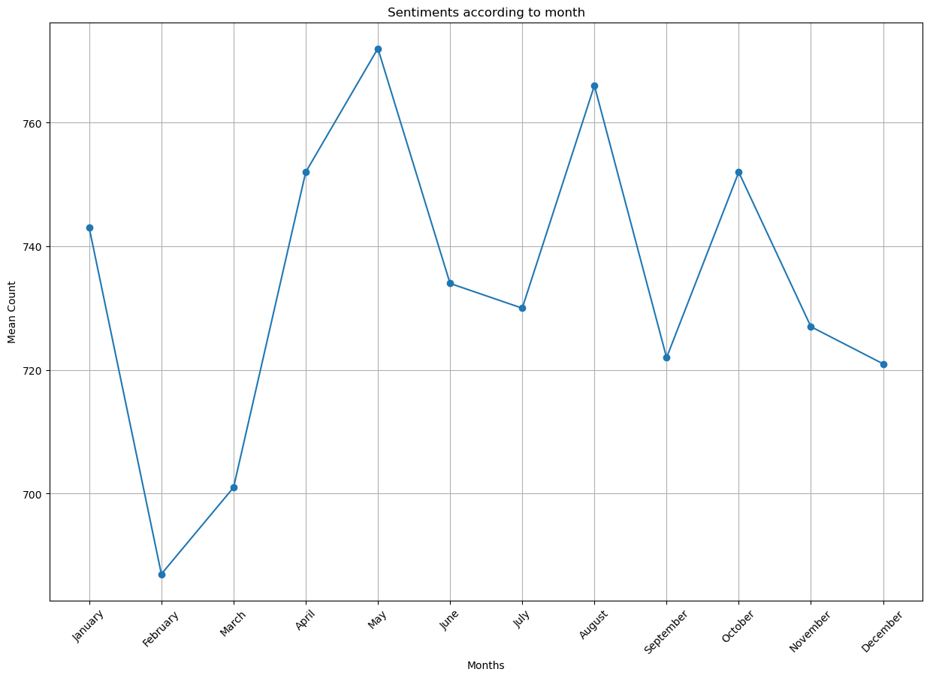
Post according to Month of the year

Slide 17

The top five categories are Animals, Science, Healthy Eating, Technology, and Food.
Animal Categories Exhibit the highest positive, negative, and neutral sentiments among the top five categories.
The highest content types for the top 5 categories are audio, followed by photos.
56.4% of the reactions are positive, 31.1% are negative sentiment and 12.5% are neutral
53.9% of the yearly score is from 2020, while 46.1% is from 2021.
Friday has the highest number of posts, followed by Sunday. Saturday records the lowest posting activity.
May sees the highest number of posts, with August and February recording the lowest posting activity.
Summary

Slide 18
Animal-related content should be a point of focus, as it gains the highest positive sentiments.
Consider diversifying content types to maintain engagement, with a focus on audio content.
Factors that contribute to the changes in the yearly scores between 2020 and 2021 should be focused on.
Optimize posting schedules to take advantage of peak days (Friday and Sunday) for increased visibility.
Align content creation strategies with the observed posting patterns for each month, with particular emphasis on the peak in May.
Recommendations

Slide 19
Thank you!
ANY QUESTIONS?

